Slide 1
Storytelling Case Study: Airbnb, NYC
By : Sushma Mahagaonkar, Snehil Tiwari and Rahul Patra

Slide 2
Objective:
Airbnb operates as an online platform that enables individuals to rent out their unused accommodations.
The COVID-19 pandemic significantly impacted Airbnb's revenue, resulting in substantial losses.
As travel restrictions ease and people resume their travel plans, Airbnb is actively working to revive its business operations and ensure readiness to serve customers once again.

Slide 3
Background
Over the recent months, Airbnb has faced a significant decrease in revenue.
With the easing of restrictions and the resurgence of travel, Airbnb is striving to be fully prepared for this transition.
To accomplish this, an analysis has been conducted on a dataset comprising diverse Airbnb listings in New York.

Slide 4
Data Preparation
The data was cleaned to eliminate any missing values and duplicate entries.
Insignificant columns were removed from the dataset to streamline the analysis.
Outliers were identified and dealt with appropriately to ensure data reliability and validity.

Slide 5
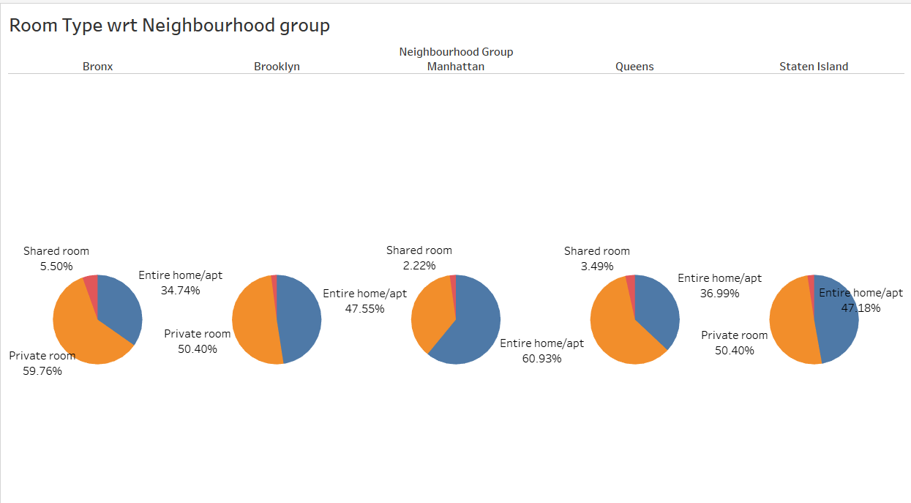
Room type with respect to Neighbourhood group
Among the neighbourhood groups, Manhattan and Brooklyn emerge as the top choices, with a high preference for booking the entire home or a private room.
Manhattan boasts the highest number of home/apt properties, accounting for approximately 60.93% of the total listed properties.
The Bronx offers the highest percentage of private rooms, with around 59.76% of the total listed properties falling into this category.
Shared rooms are relatively scarce across all neighbourhood groups, indicating a limited availability of this accommodation type.

Slide 6
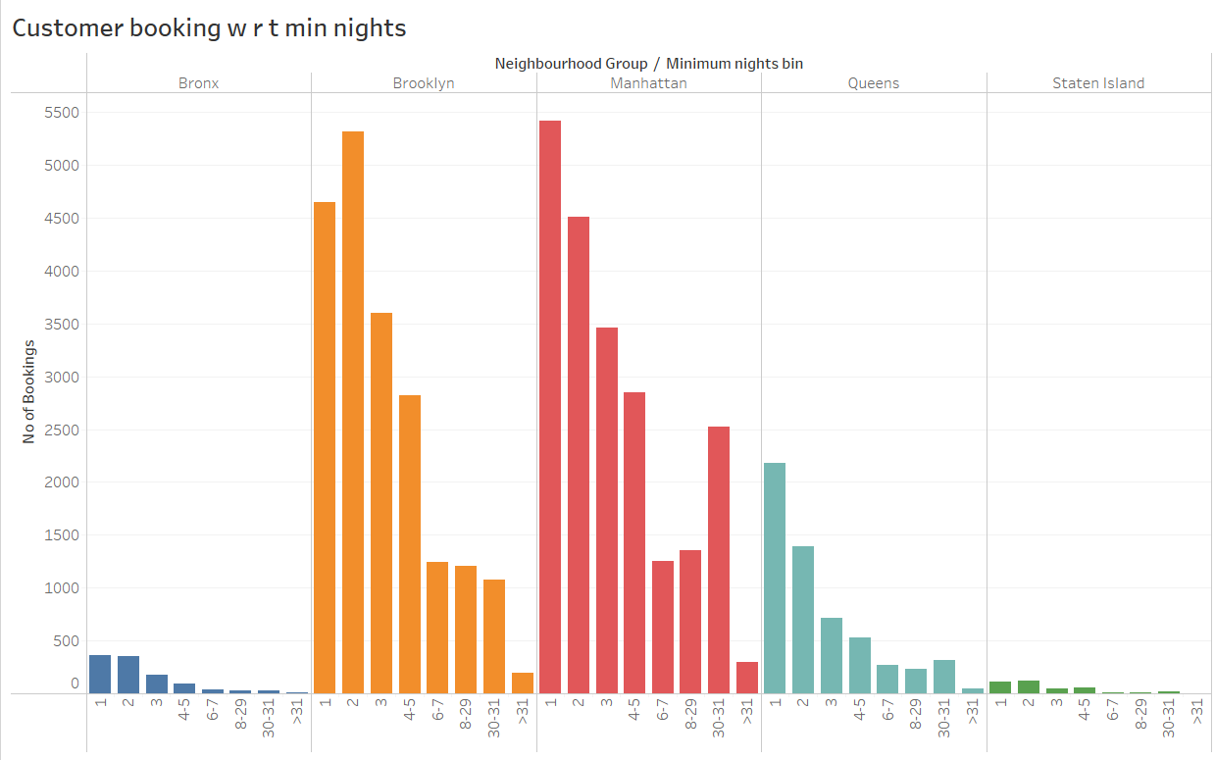
Customer Booking with respect to minimum nights
The listings with Minimum nights 1-5 have the most number of bookings. We can see a prominent spike in 30 days, this would be because customers would rent out on a monthly basis.
After 30 days, we can also see small spikes, this can also be explained by the monthly rent taking trend.
Manhattan &Queens have higher number of 30 day bookings compared to the others. The reason could be either tourists booking long stays or mid-level employees who opt for budget bookings due company visits

Slide 7
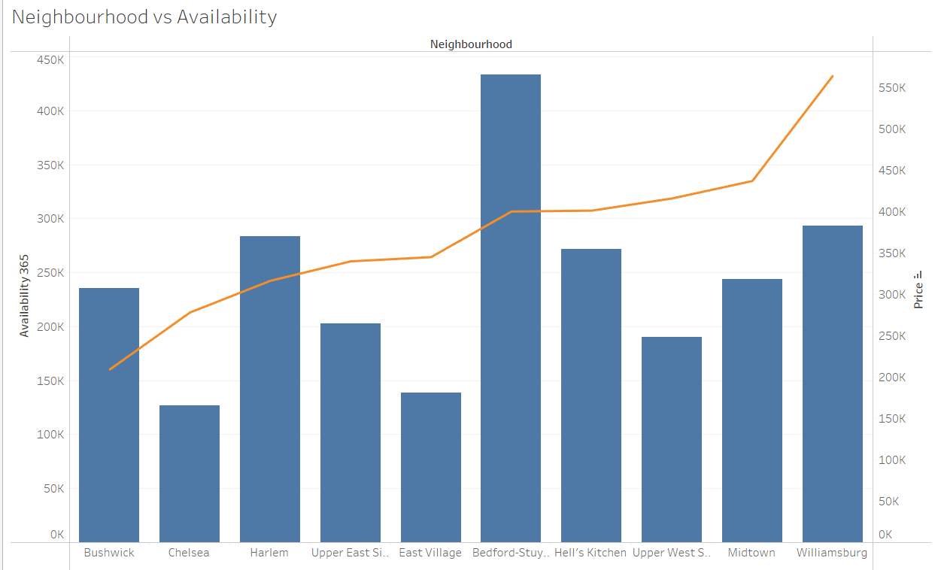
Neighbourhood vs Availability
The analysis revealed that listings with a minimum stay of 1-5 nights received the highest number of bookings. A significant spike in bookings for 30-day stays was observed, indicating a preference for monthly rentals among customers.
Additionally, smaller spikes beyond 30 days were observed, which can be attributed to the trend of monthly rentals.
In terms of specific neighbourhoods, Manhattan and Queens had a higher number of 30-day bookings compared to other areas. This can be attributed to either tourists opting for longer stays or mid-level employees seeking budget-friendly accommodations for company visits.

Slide 8
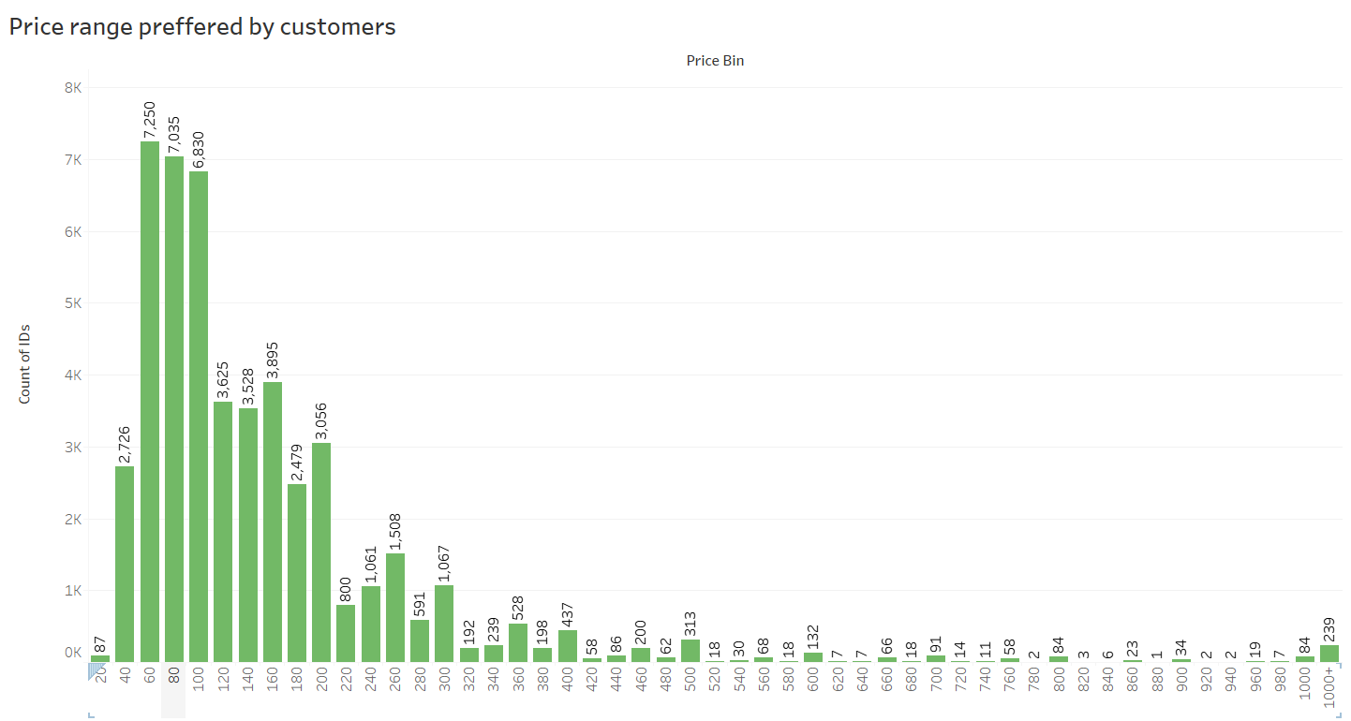
Price range preferred by Customers
Pricing preference was determined based on the volume of bookings in different price ranges.
Both graphs indicate that the most favored price range among customers is $60 - $200. This price range is preferred by the majority of customers.

Slide 9
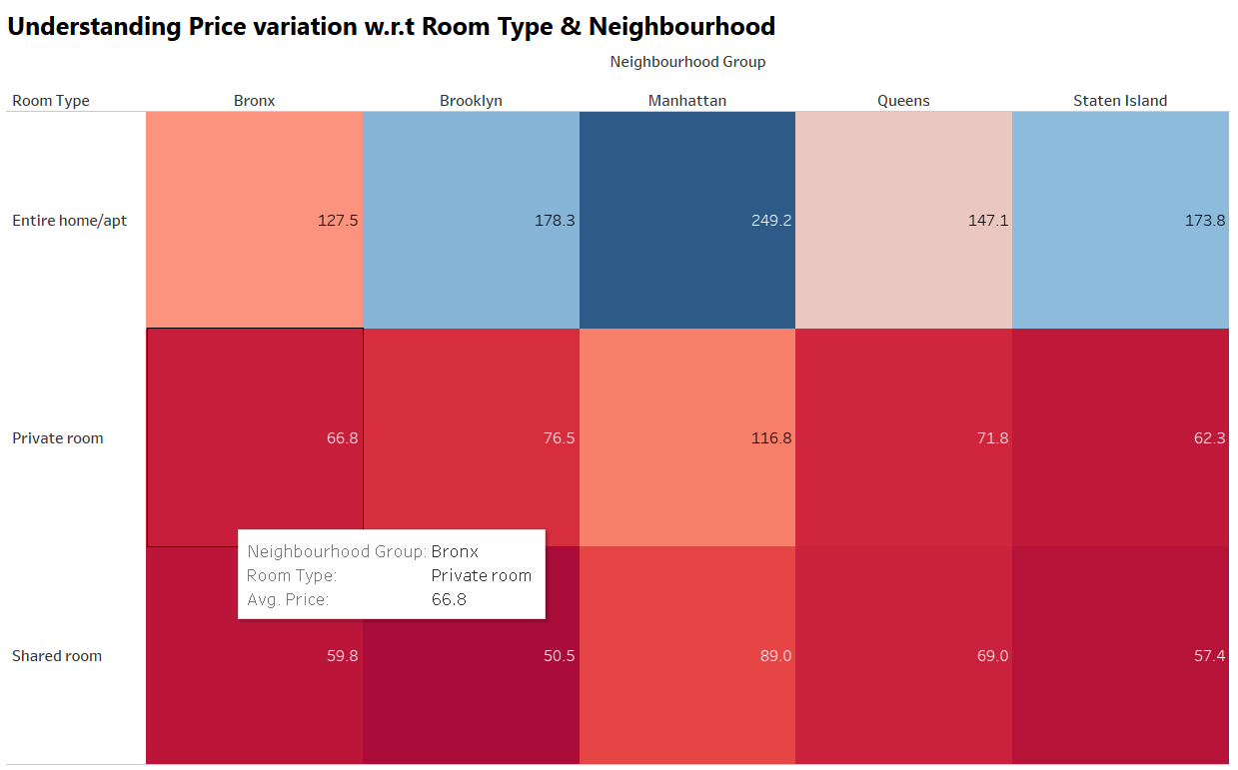
Understanding Price variation w.r.t Room Type & Neighbourhood
The 'Entire home/apt' room type in Manhattan stands out as the most expensive option, with an average price of $250, significantly higher than the overall average.
In both Manhattan and Brooklyn, the 'private room' type demonstrates the highest average price among all room types.
Conversely, the 'Shared Room' type in Brooklyn is the most affordable, with an average price of $50.5.

Slide 10
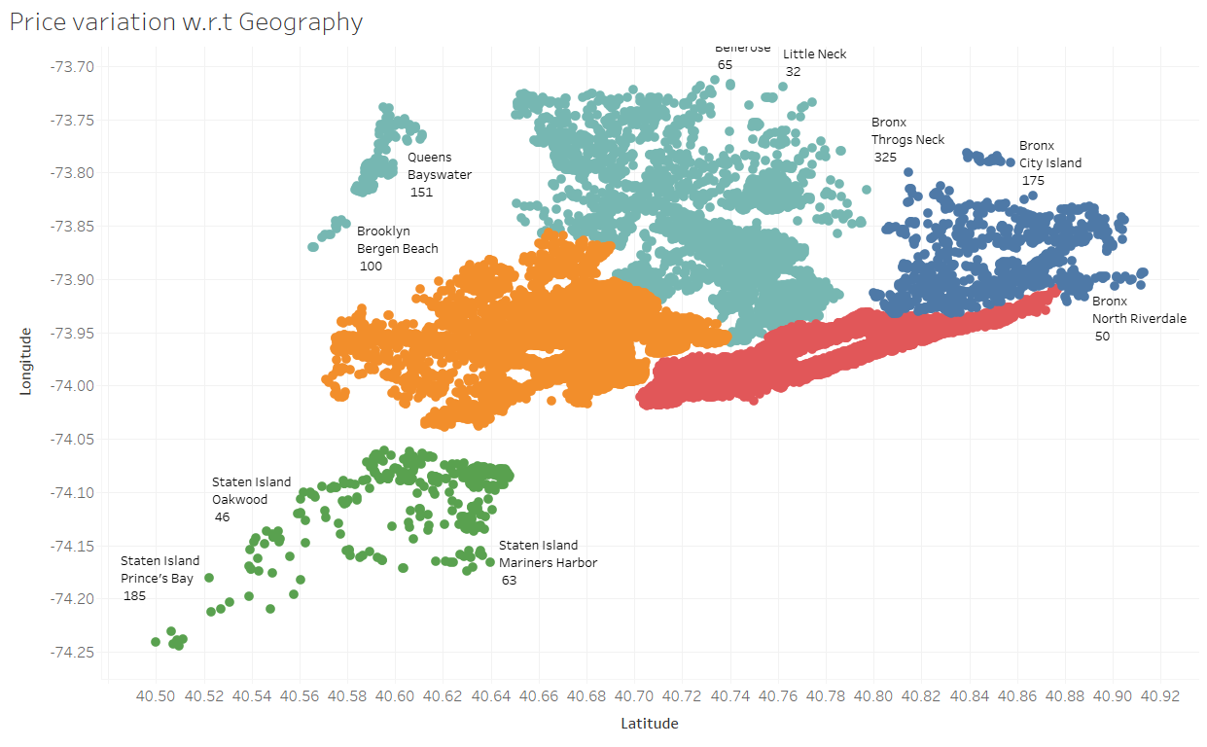
Price variation with respect to Geography
Airbnb has established a strong presence in Manhattan, Brooklyn, and Queens.
The highest number of listings can be found in Manhattan and Brooklyn, which can be attributed to their high population density and status as major financial and tourism hubs within New York City.
On the other hand, Staten Island has the fewest number of listings due to its lower population density and limited tourism destinations.

Slide 11
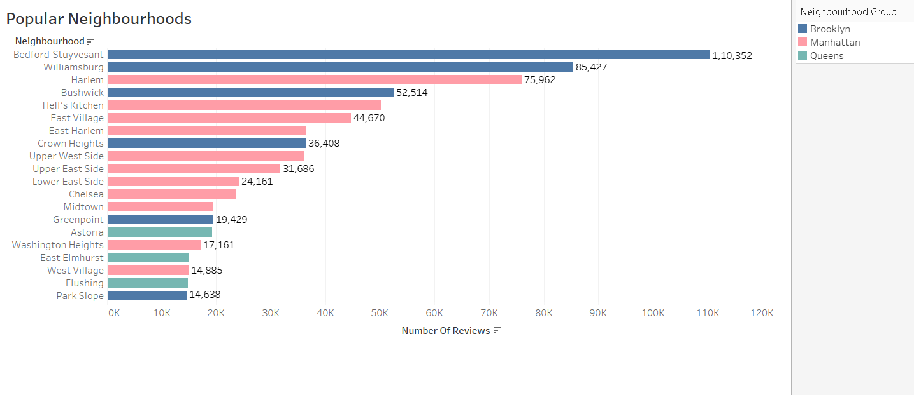
Popular Neighborhoods
We observe that Bedford-Stuyvesant in Brooklyn has the highest popularity, with a total of 1,10,352 reviews, followed by Williamsburg.
Harlem in Manhattan has the highest number of reviews, closely followed by Hell's Kitchen.
The abundance of customer reviews indicates a higher level of satisfaction in these neighborhoods.

